Slide 1
Interactive Visual Data Analysis
08 – Graph visualization

Slide 2
Objectives
How to visualize graph data: Learn approaches and techniques for visualizing relations between objects
How to include additional data facets: Learn basic approaches for visualizing multi-faceted graphs

Slide 3
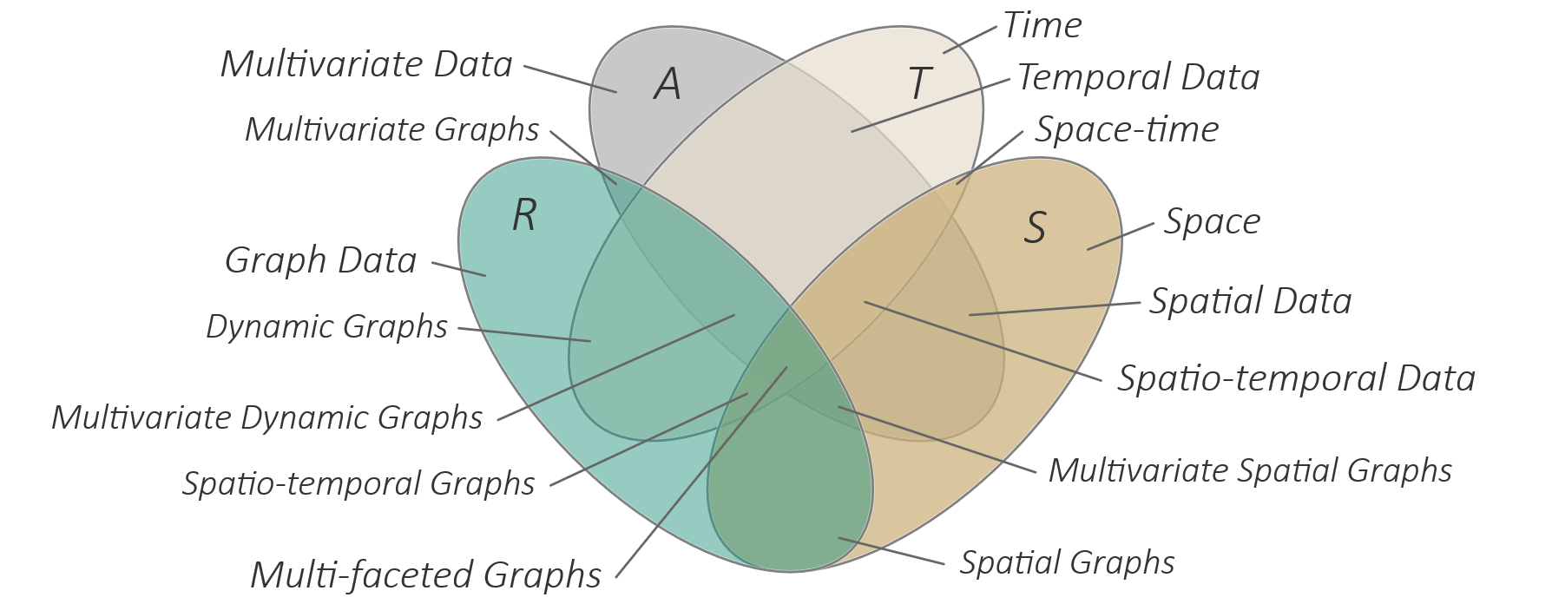
Overview
Graph data
Basic visual representations
Visualizing multi-faceted graphs

Slide 4
Motivation
So far, we considered data attributes A in time T and space S
Now we are concerned with relations R between data elements
Graphs are a universal model for representing relations between entities
Graphs relevant in many application domains
File system hierarchies
Computer networks
Social networks
Biological reaction networks
Power grids
Think about: Where else are graphs relevant?
There is a great demand for graph visualization!
Notes:
Dependency graphs (software)
Molecular graphs (chemistry)
Company organizational structures (business)

Slide 5
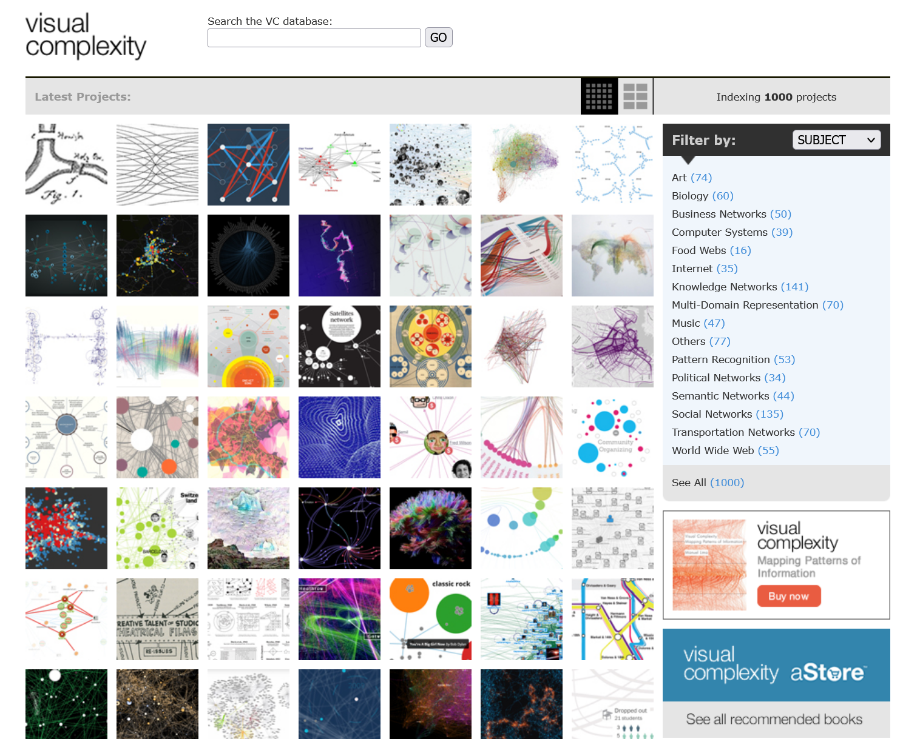
Motivation
There is a great demand for graph visualization!
There is also a great supply of graph visualizations!
www.visualcomplexity.com
Notes:
Dependency graphs (software)
Molecular graphs (chemistry)
Company organizational structures (business)

Slide 6
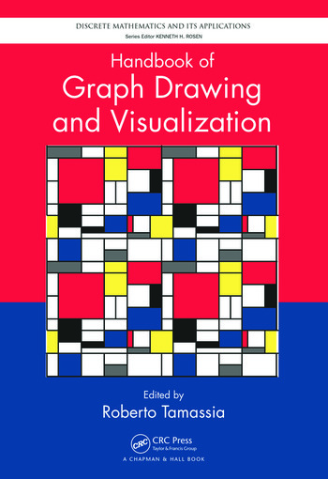
Graph visualization
https://cs.brown.edu/people/rtamassi/gdhandbook/
Graph visualization is concerned with
Showing structural relationships R
Representing data attributes A associated with R
Indicating potential dependencies on time T and space S
Note: We can fill whole books with the topic of graph visualization alone, other books focus on multivariate graph visualization, and substantial articles take dynamic graph visualization and visualization of geographic networks into account.

Slide 7
Graph data
9
j
k
2
f
5
Graphs $G=(V,E)$
Set of vertices $V$ (the entities or data objects)
Set of edges $E$ (the relations between entities)
Directed pairs $\left(u,v\right)∈E :u,v∈V$
Undirected tuples $\left\{u,v\right\}∈E :u,v∈V$
Additionally: Derived or associated data attributes
Graphs stored as
Set representation
Adjacency list
Adjacency matrix
Incidence matrix
b
a
g
6
i
3
e
h
d
c
7
4
 | 2 | 3 | 4 | 5 | 6 | 7 | 9
2
3
4
5
6
7
9
 | a | b | c | d | e | f | g | h | i | j | k
2
3
4
5
6
7
9
2 | → 3 → 6
3 | → 4 → 7
4 | 5
5 | → 2 → 3
6 | →
7 | → 2 → 6
9 | → 2 → 5

Slide 8
Graph data
Graphs $G=(V,E)$
Relevant types of graphs
Networks
No particular constraints for nodes and edges
Examples: social networks, computer networks, transportation networks, …
Trees
Connected, acyclic graph of parent-child relations (path exists between any nodes u and v, no path where start and end node are the same)
Designated root node, leaf nodes with no outgoing edges
Examples: File system, organizational hierarchies, …
Further:
Bi-partite graphs (two distinct subsets of nodes, edges only between subsets)
Hypergraphs (edges between more than two nodes)
Multi-layer graphs (graphs where nodes and edges exist on different layer)
From a graph-theoretical perspective, there are more than 1.600 graph classes (see https://graphclasses.org/).

Slide 9
Graph data
Facets of graphs
Plain graphs (R) Multivariate graphs (R+A) Dynamic graphs (R+T) Spatial graphs (R+S) Compound graphs (R+H)

Slide 10
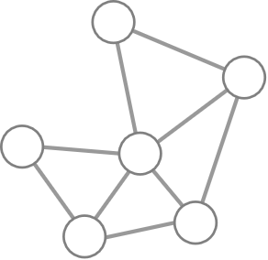
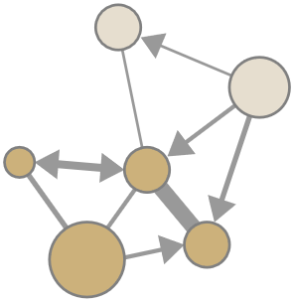
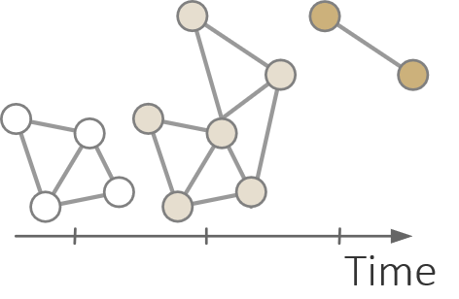
Graph data
Facets of graphs
Plain graphs (R)
Structure as primary facet
Multivariate graphs (R+A)
Nodes and edges as data objects with additional given or derived data attributes
Example attributes: Node degree, edge weight
Dynamic graphs (R+T)
Vary over time, where nodes and edges can continue to exists, leave, or enter the graph
Example: Social network with new persons and new connections

Slide 11
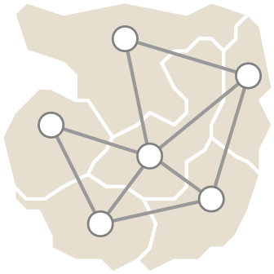
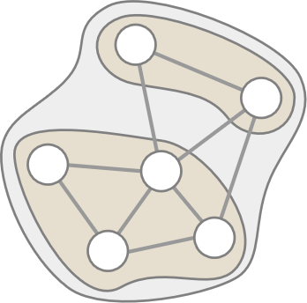
Graph data
Facets of graphs
Spatial graphs (R+S)
Associated with coordinates in space
Coordinates may prescribe graph layout and edge routes
Example: Flights connecting airports, road network
Compound graphs (R+H)
Nodes and edges partitioned into groups
Typically structured in a nesting hierarchy H
Groups can be expanded or collapsed to create different levels of abstraction
Example: Social network with organizational hierarchy on top, clustered graph

Slide 12
Analytical questions for graph data
Think about: What data objects might be relevant when analyzing graphs?
Relevant data objects
Nodes (degree, centrality, …)
Edges (directedness, weight, centrality, …)
Paths (length, costs, …)
Graphs and subgraphs (node and edge count, number of *, …)
Connected components (there is a path between any two nodes)
Clusters (or communities) defined by graph structure (e.g., cliques = fully connected subgraphs)
Groups of elements with similar properties (e.g., edges with high weights)

Slide 13
Analytical questions for graph data
Think about: What analytical questions may we ask about graphs?
Some example questions
Who is connected to whom?
Is there a connection between two entities?
Are there community structures?
Who is the central player in a network?
Are there critical connections (which cause trouble when broken)?
…
Next, we look at a taxonomy for graph visualization tasks

Slide 14
Analytical questions for graph data
Task taxonomy for graph visualization (Lee et al., 2006)
Topology-based tasks
Find the set of nodes adjacent to a node
Find the set of nodes accessible from a node
Given nodes, find a set of nodes that are connected to all of them
Find the shortest path between two nodes
…
Attribute-based tasks
Find the nodes having a specific attribute value
Given a node, find the nodes connected only by certain types of links
Which node is connected by a link having the largest/smallest value
…

Slide 15
Analytical questions for graph data
Task taxonomy for graph visualization (Lee et al., 2006)
Browsing tasks
Follow a given path
Return to a previously visited node
…
Overview tasks
Compound exploratory tasks for quick estimation of
Graph size
Number of connected components
…

Slide 16
Basic visual representations
We now know about graph data and corresponding analytical questions, next we study basic visual representations for graphs
Four fundamental visual designs
Node-link representations
Matrix representations
Implicit representations
Hybrid representations

Slide 17
Node-link representations
Design questions
How to represent nodes?
How to represent edges?
How to layout nodes?
How to route edges?

Slide 18
Node-link representations
How to represent nodes?
Basic dots
Size-varying, color-coded circles
Glyphs
How to represent edges?
Straight lines
Curves
Orthogonal paths

Slide 19
Node-link representations
Think about: What are criteria for a good node layout and edge routing?
Aesthetics criteria (Bennett et al., 2007)
Node metrics
Edge metrics
Overall layout metrics

Slide 20
Node-link representations
Aesthetics criteria (Bennett et al., 2007)
Node metrics
Cluster similar nodes
Distribute nodes evenly
Keep nodes apart from edges
…
Edge metrics
Minimize edge crossings
Keep edge length uniform
Minimize edge length
Minimize edge bends
…

Slide 21
Node-link representations
Aesthetics criteria (Bennett et al., 2007)
Overall layout metrics
Maximize consistent flow direction
Keep correct aspect ratio
Minimize area
Maximize local/global symmetry
…
Summary
Various partially conflicting aesthetics criteria
No silver-bullet solution → Need to find good compromise

Slide 22
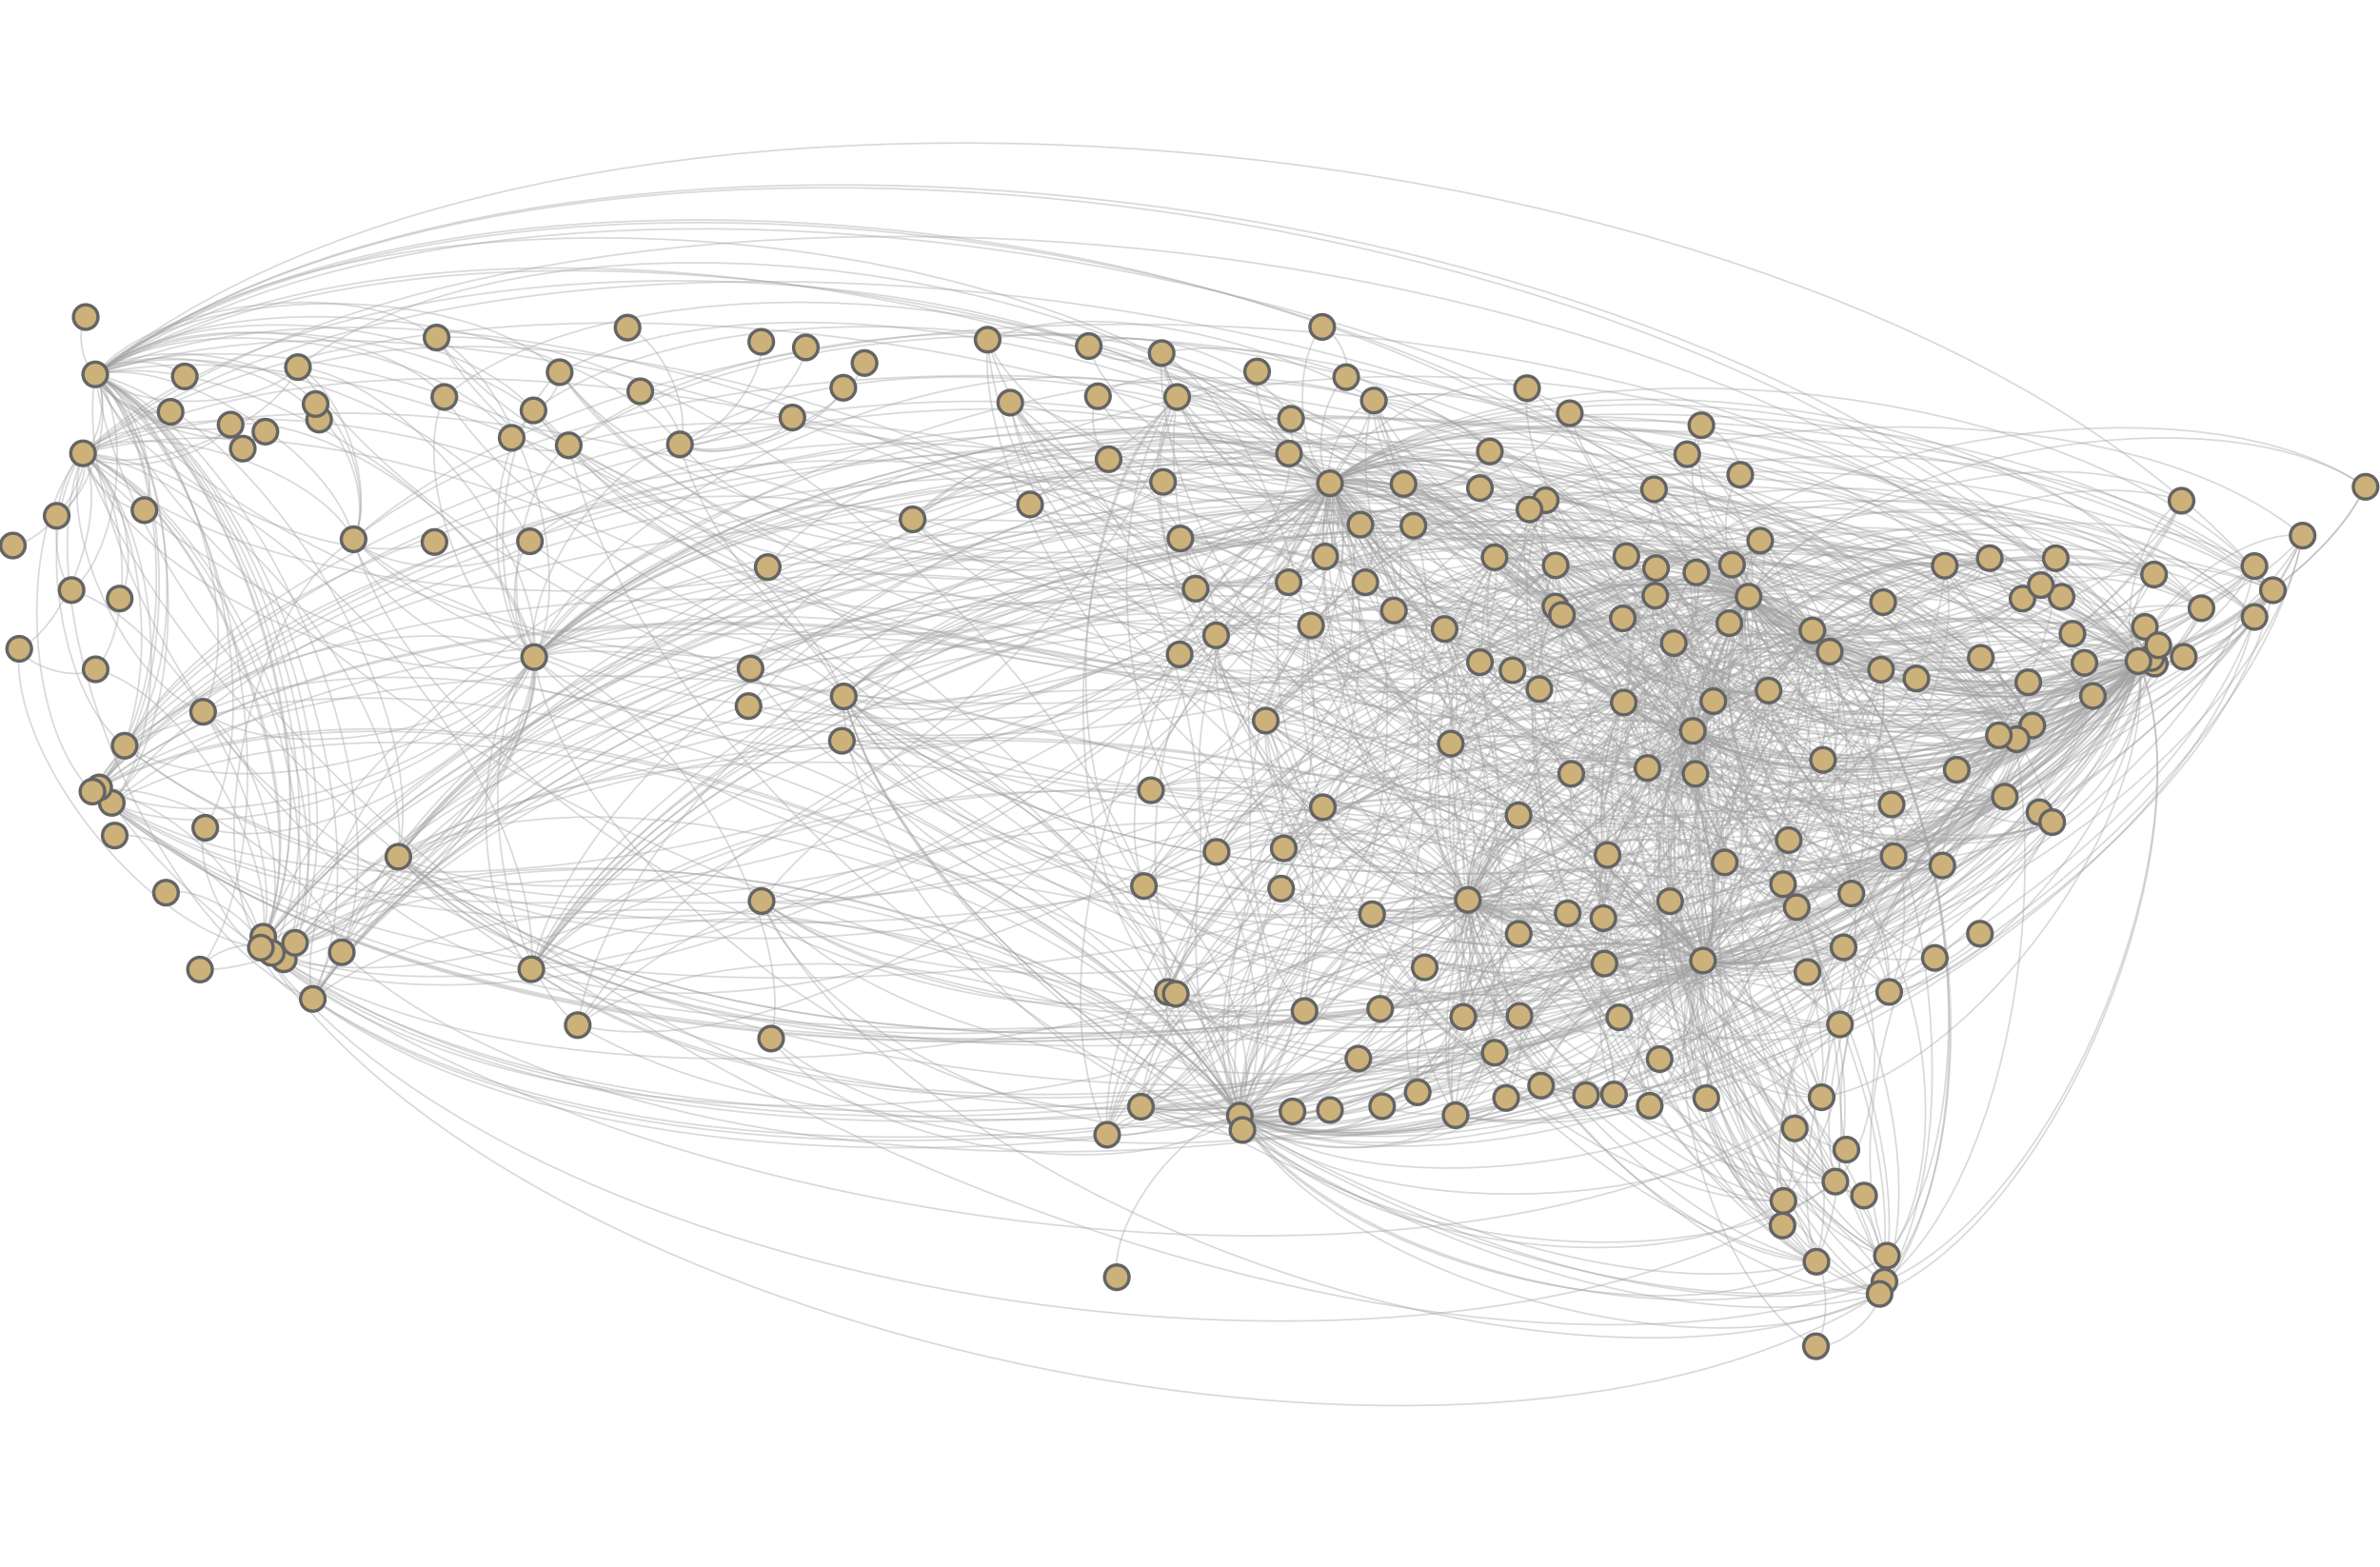
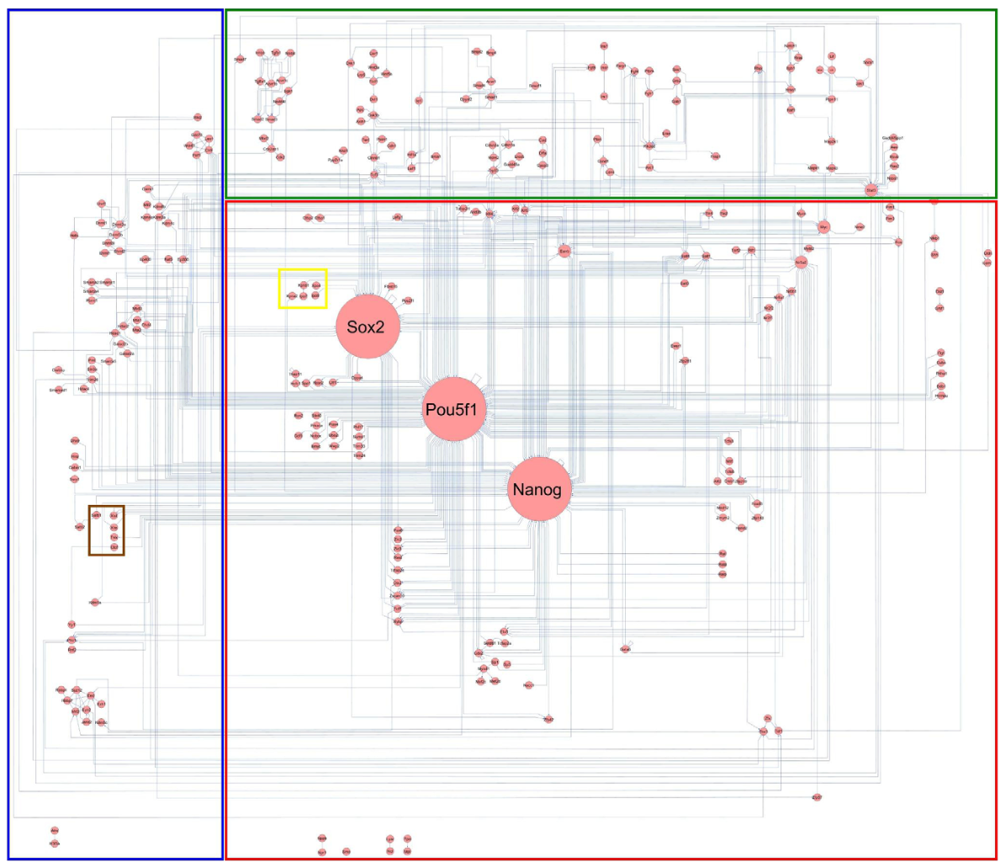
Node-link representations
Stylized layout of network of 574 molecular interactions, stimulations and inhibitions
Fixed layout of US flight routes
How to layout nodes?
Fixed layout
Node positions are predefined and cannot be varied
Example: Flight route network
Stylized layout
Possible positions confined to some predefined scheme (e.g., circle, regions)
Node positions may vary only with respect to scheme (e.g., on circle, in region)
Examples: Magic-eye view, Fisheye treeview for trees
Free layout
Nodes can be positioned freely
Example: Force-directed layout for general graphs

Slide 23
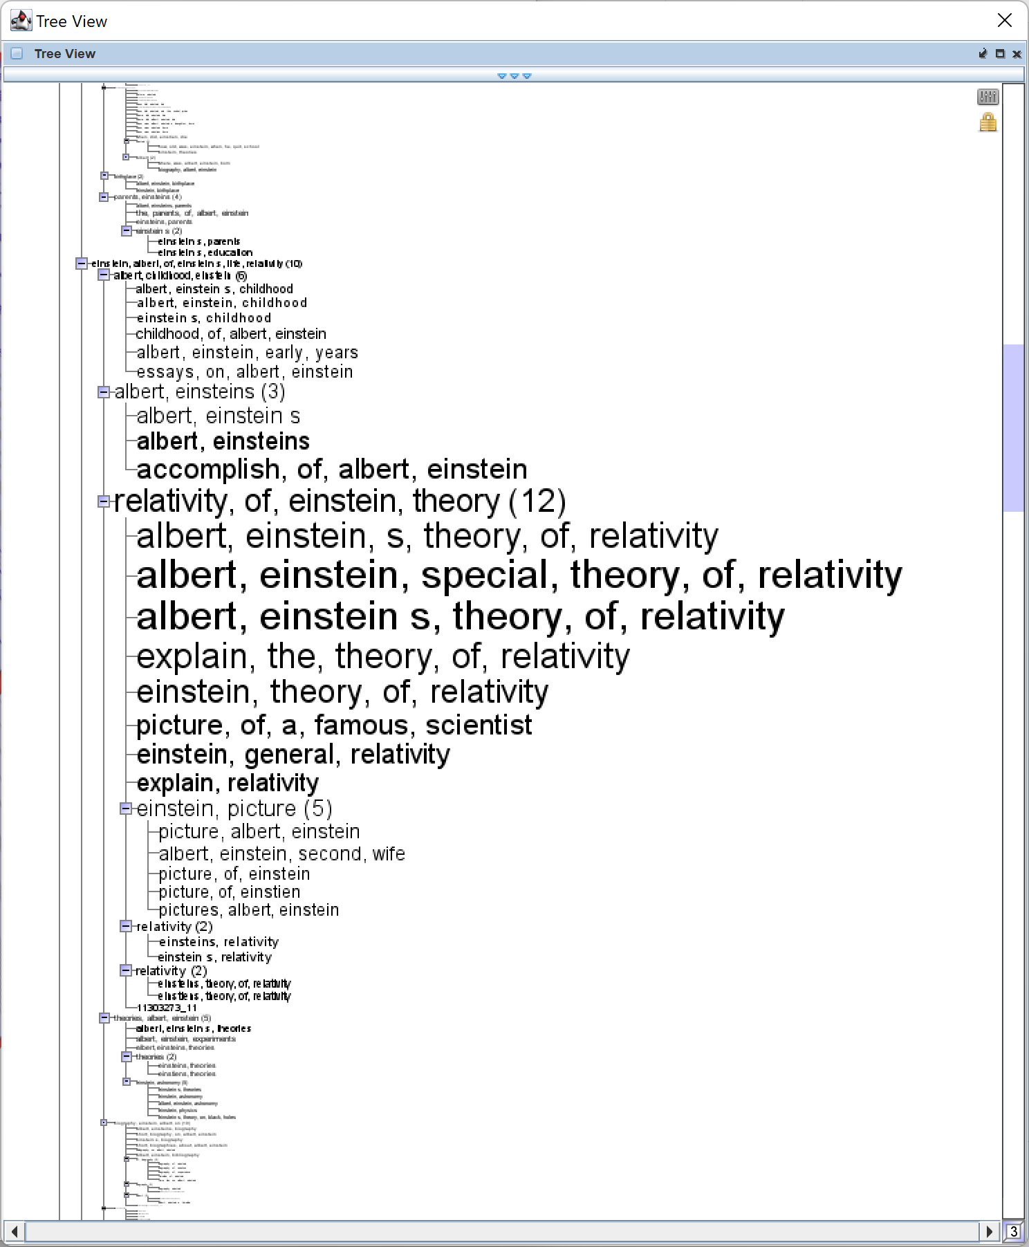
Node-link representations
Fisheye treeview (stylized layout)
Classic indentation-based treeview
Focused on showing node labels
Enhanced with:
Zoom
Animations
Fisheye distortion
Demo

Slide 24
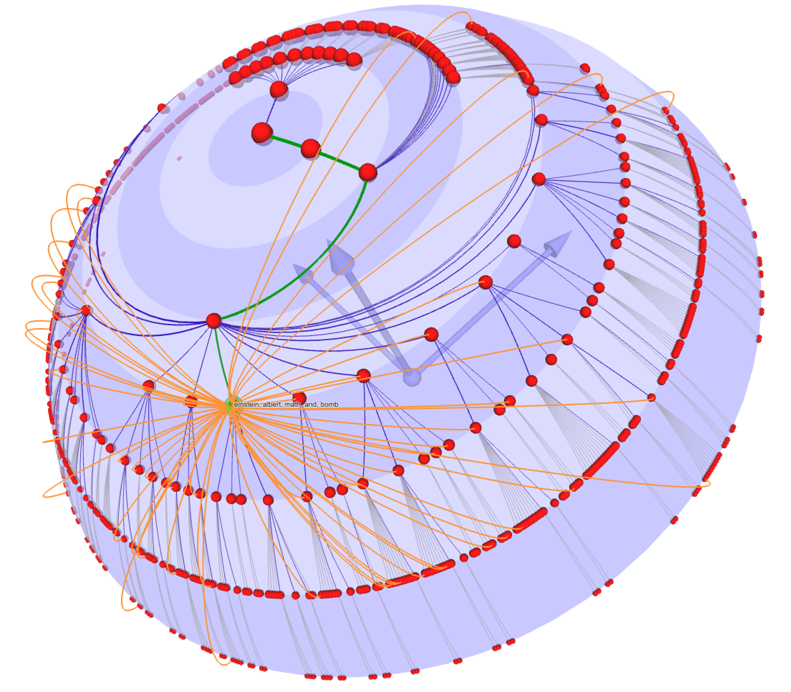
Node-link representations
Magic Eye View (stylized layout)
Radial variant of Walker’s layout
Projected onto 3D hemisphere
Enhanced with:
Cross edges
Focus-point adjustment
Interactive rotation
Demo

Slide 25
Node-link representations
Force-directed layout (free layout)
Compute graph layout via physical forces:
Nodes as point masses with position, velocity, and acceleration
Two primary types of forces:
Repulsive forces between all nodes
Attractive forces between connected nodes (e.g., edges as springs)
Additional forces:
Gravity to keep disconnected nodes and subgraphs from floating away
Cluster forces to keep distances between clusters

Slide 26
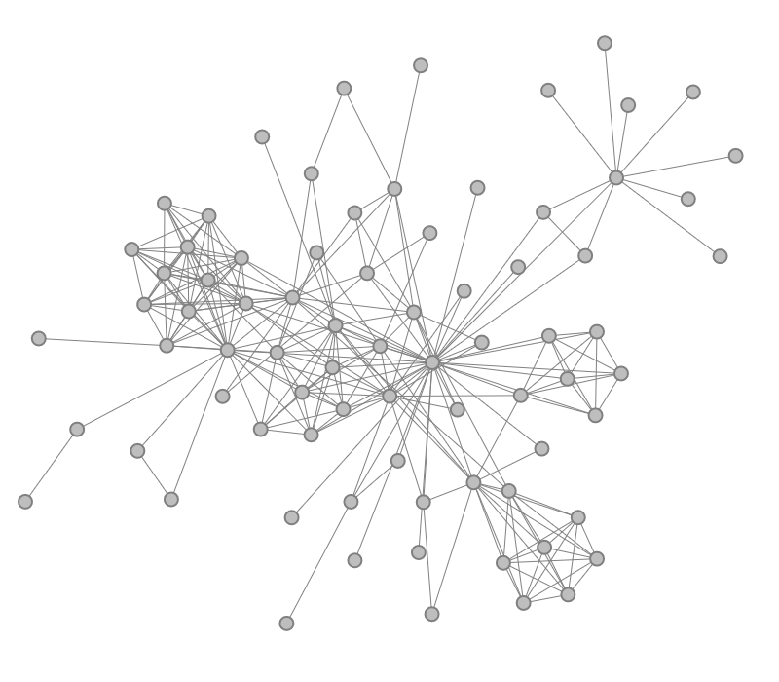
Node-link representations
Force-directed layout of the co-occurrence network of character of the novel “Les Miserables”
Force-directed layout
Initialize positions (randomly)
Compute forces based on current positions
Compute force-induced accelerations
Update velocities according to acceleration
Update positions according to velocity
Repeat 2. until reasonable stop criterion

Slide 27
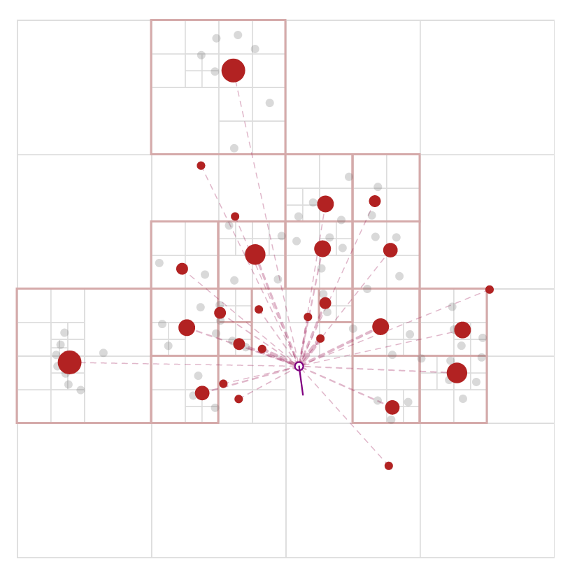
Node-link representations
Force-directed layout
Think about: What is the computational complexity?
Computational complexity
Naïve O(n²)
Barnes-Hut O(n log n)
https://jheer.github.io/barnes-hut/

Slide 28
Node-link representations
There is a reading assignment that will provide some more information on the Eades, Fruchterman & Reingold and the Kamada & Kawai algorithms
Force-directed layout
Different variants of force-directed layout algorithms
Eades
Fruchterman & Reingold
Kamada & Kawai
ForceAtlas, ForceAtlas2
Yifan Hu’s Multi-level layout
Gephi software offers different options for testing https://gephi.org

Slide 29
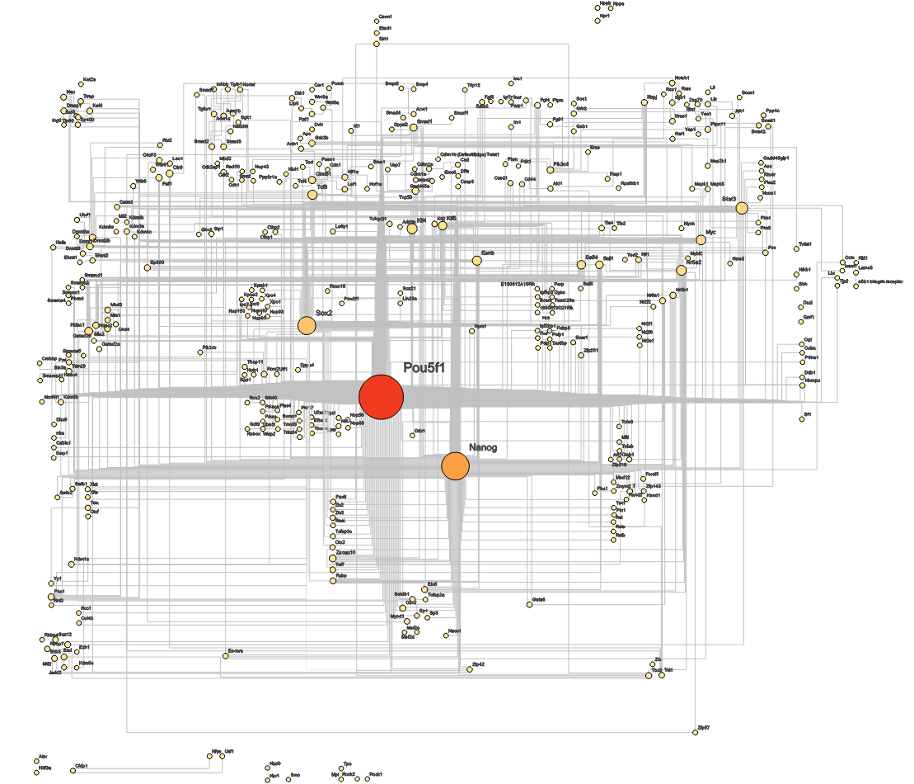
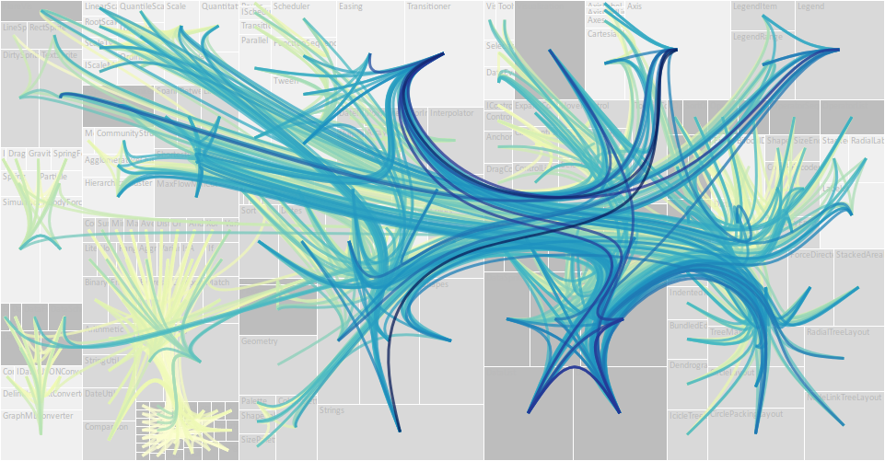
Node-link representations
How to route edges?
Straight edges
Orthogonal edges
Curved edges
Edge bundling

Slide 30
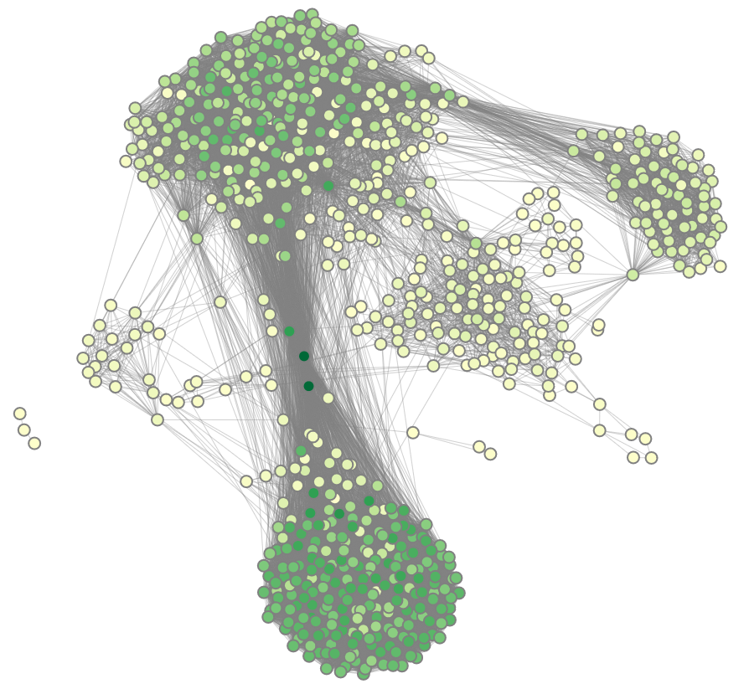
Node-link representations
Force-directed layout of a social network
Summary
Advantages
Good overview of graph structure
All graph elements represented explicitly
Generally applicable
Disadvantages
Complex layout calculation
Numeric (in)stability
“Hairball” for large graphs

Slide 31
Basic visual representations
Four fundamental visual designs
Node-link representations
Matrix representations
Implicit representations
Hybrid representations

Slide 32
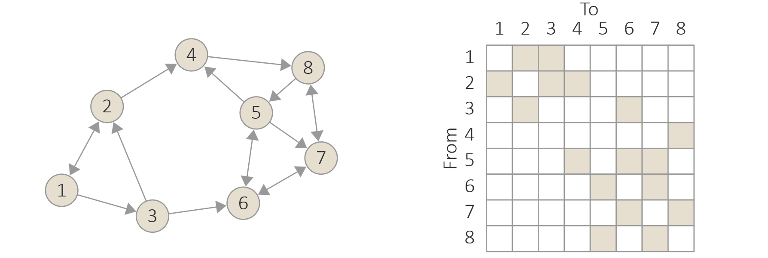
Matrix representations
Graph represented as matrix
Matrix rows and columns correspond to nodes
Matrix cells visualize edges
Filled cells indicate existence of edge between column node and row node
Edge attribute(s) visualized via
Color-coding
Embedded miniature visualization (e.g., glyphs)

Slide 33
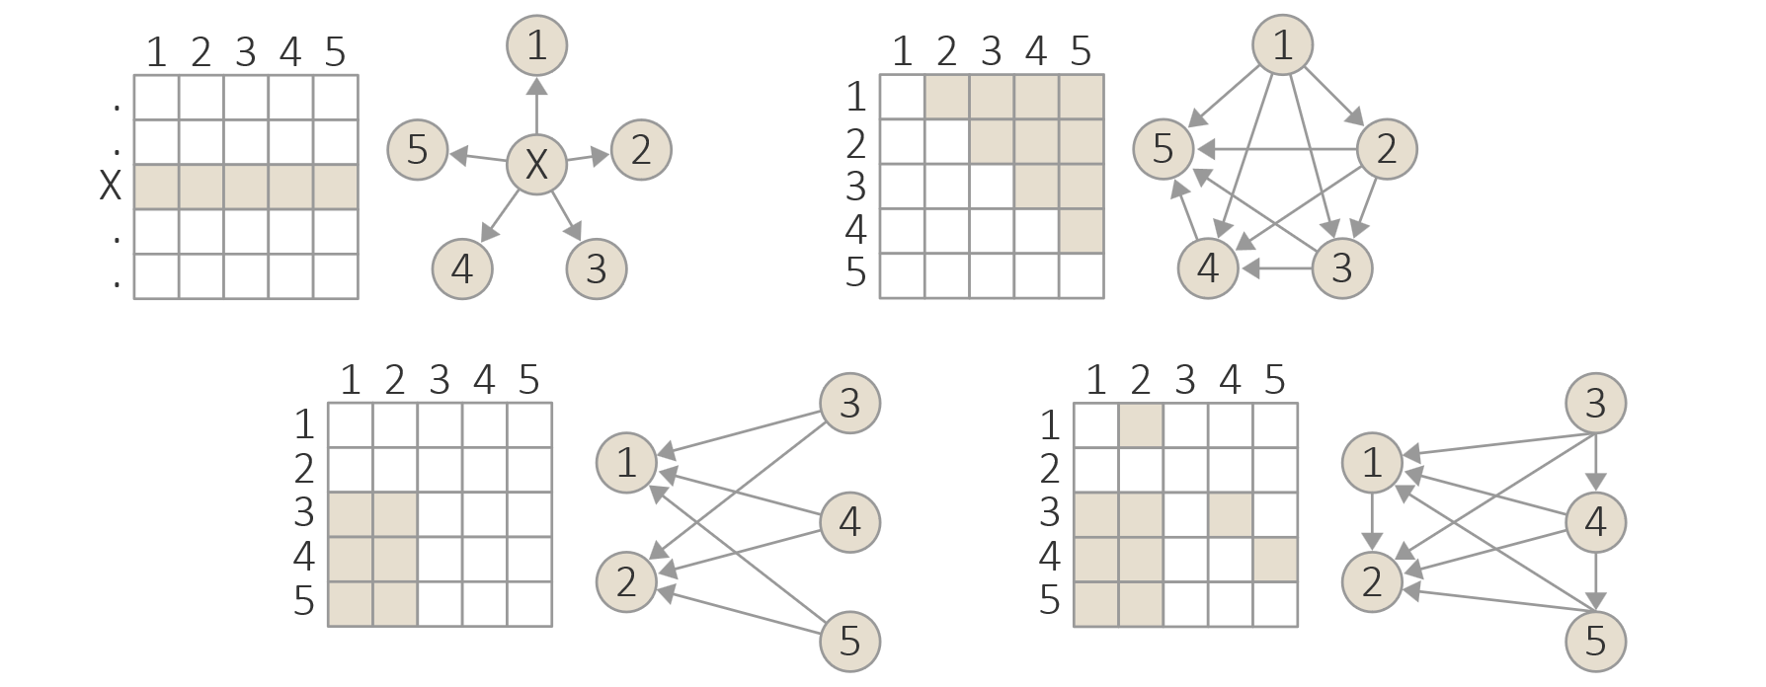
Matrix representations
Visual patterns indicting structural properties of graphs

Slide 34
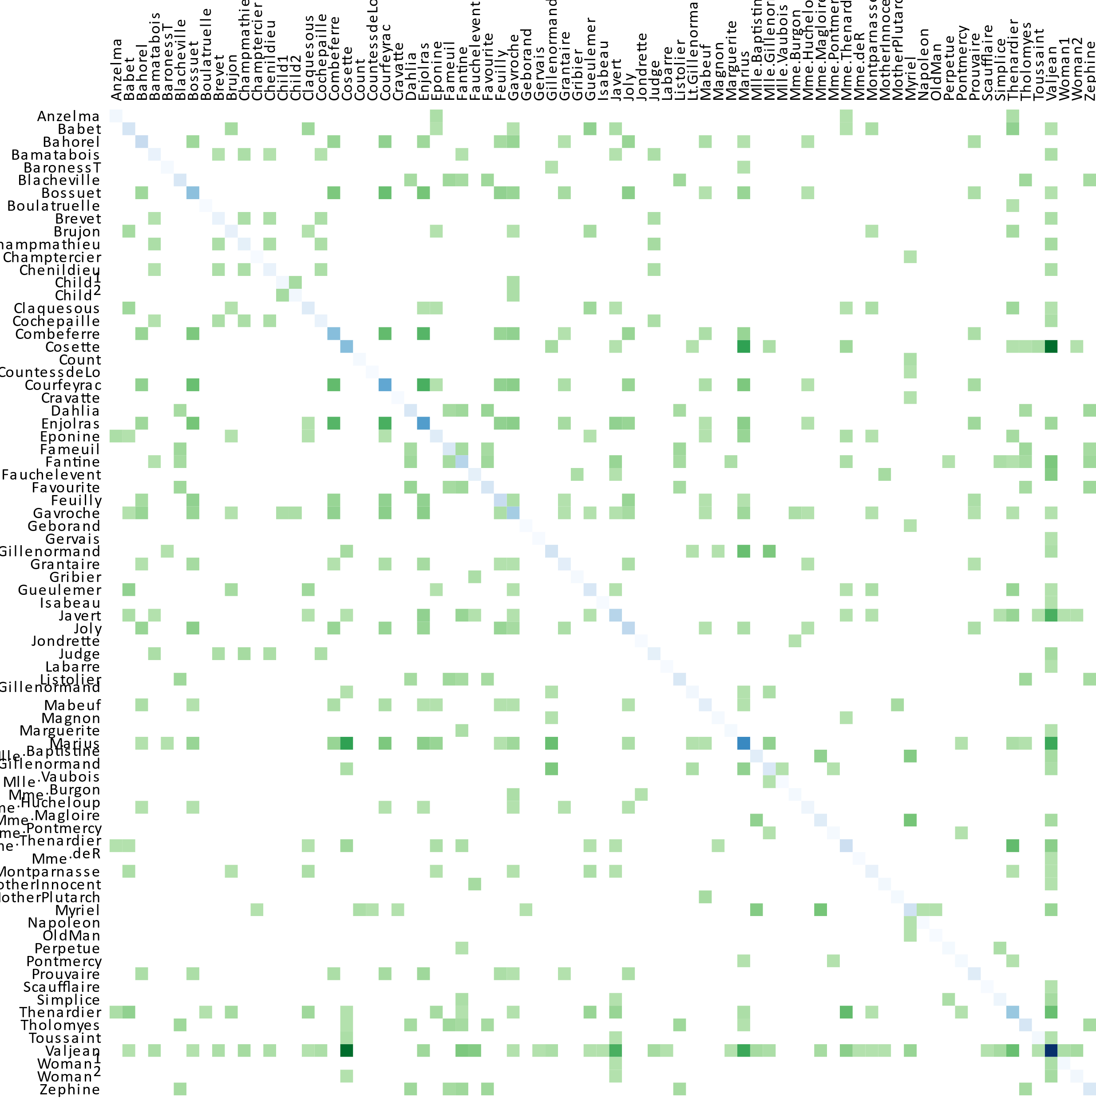
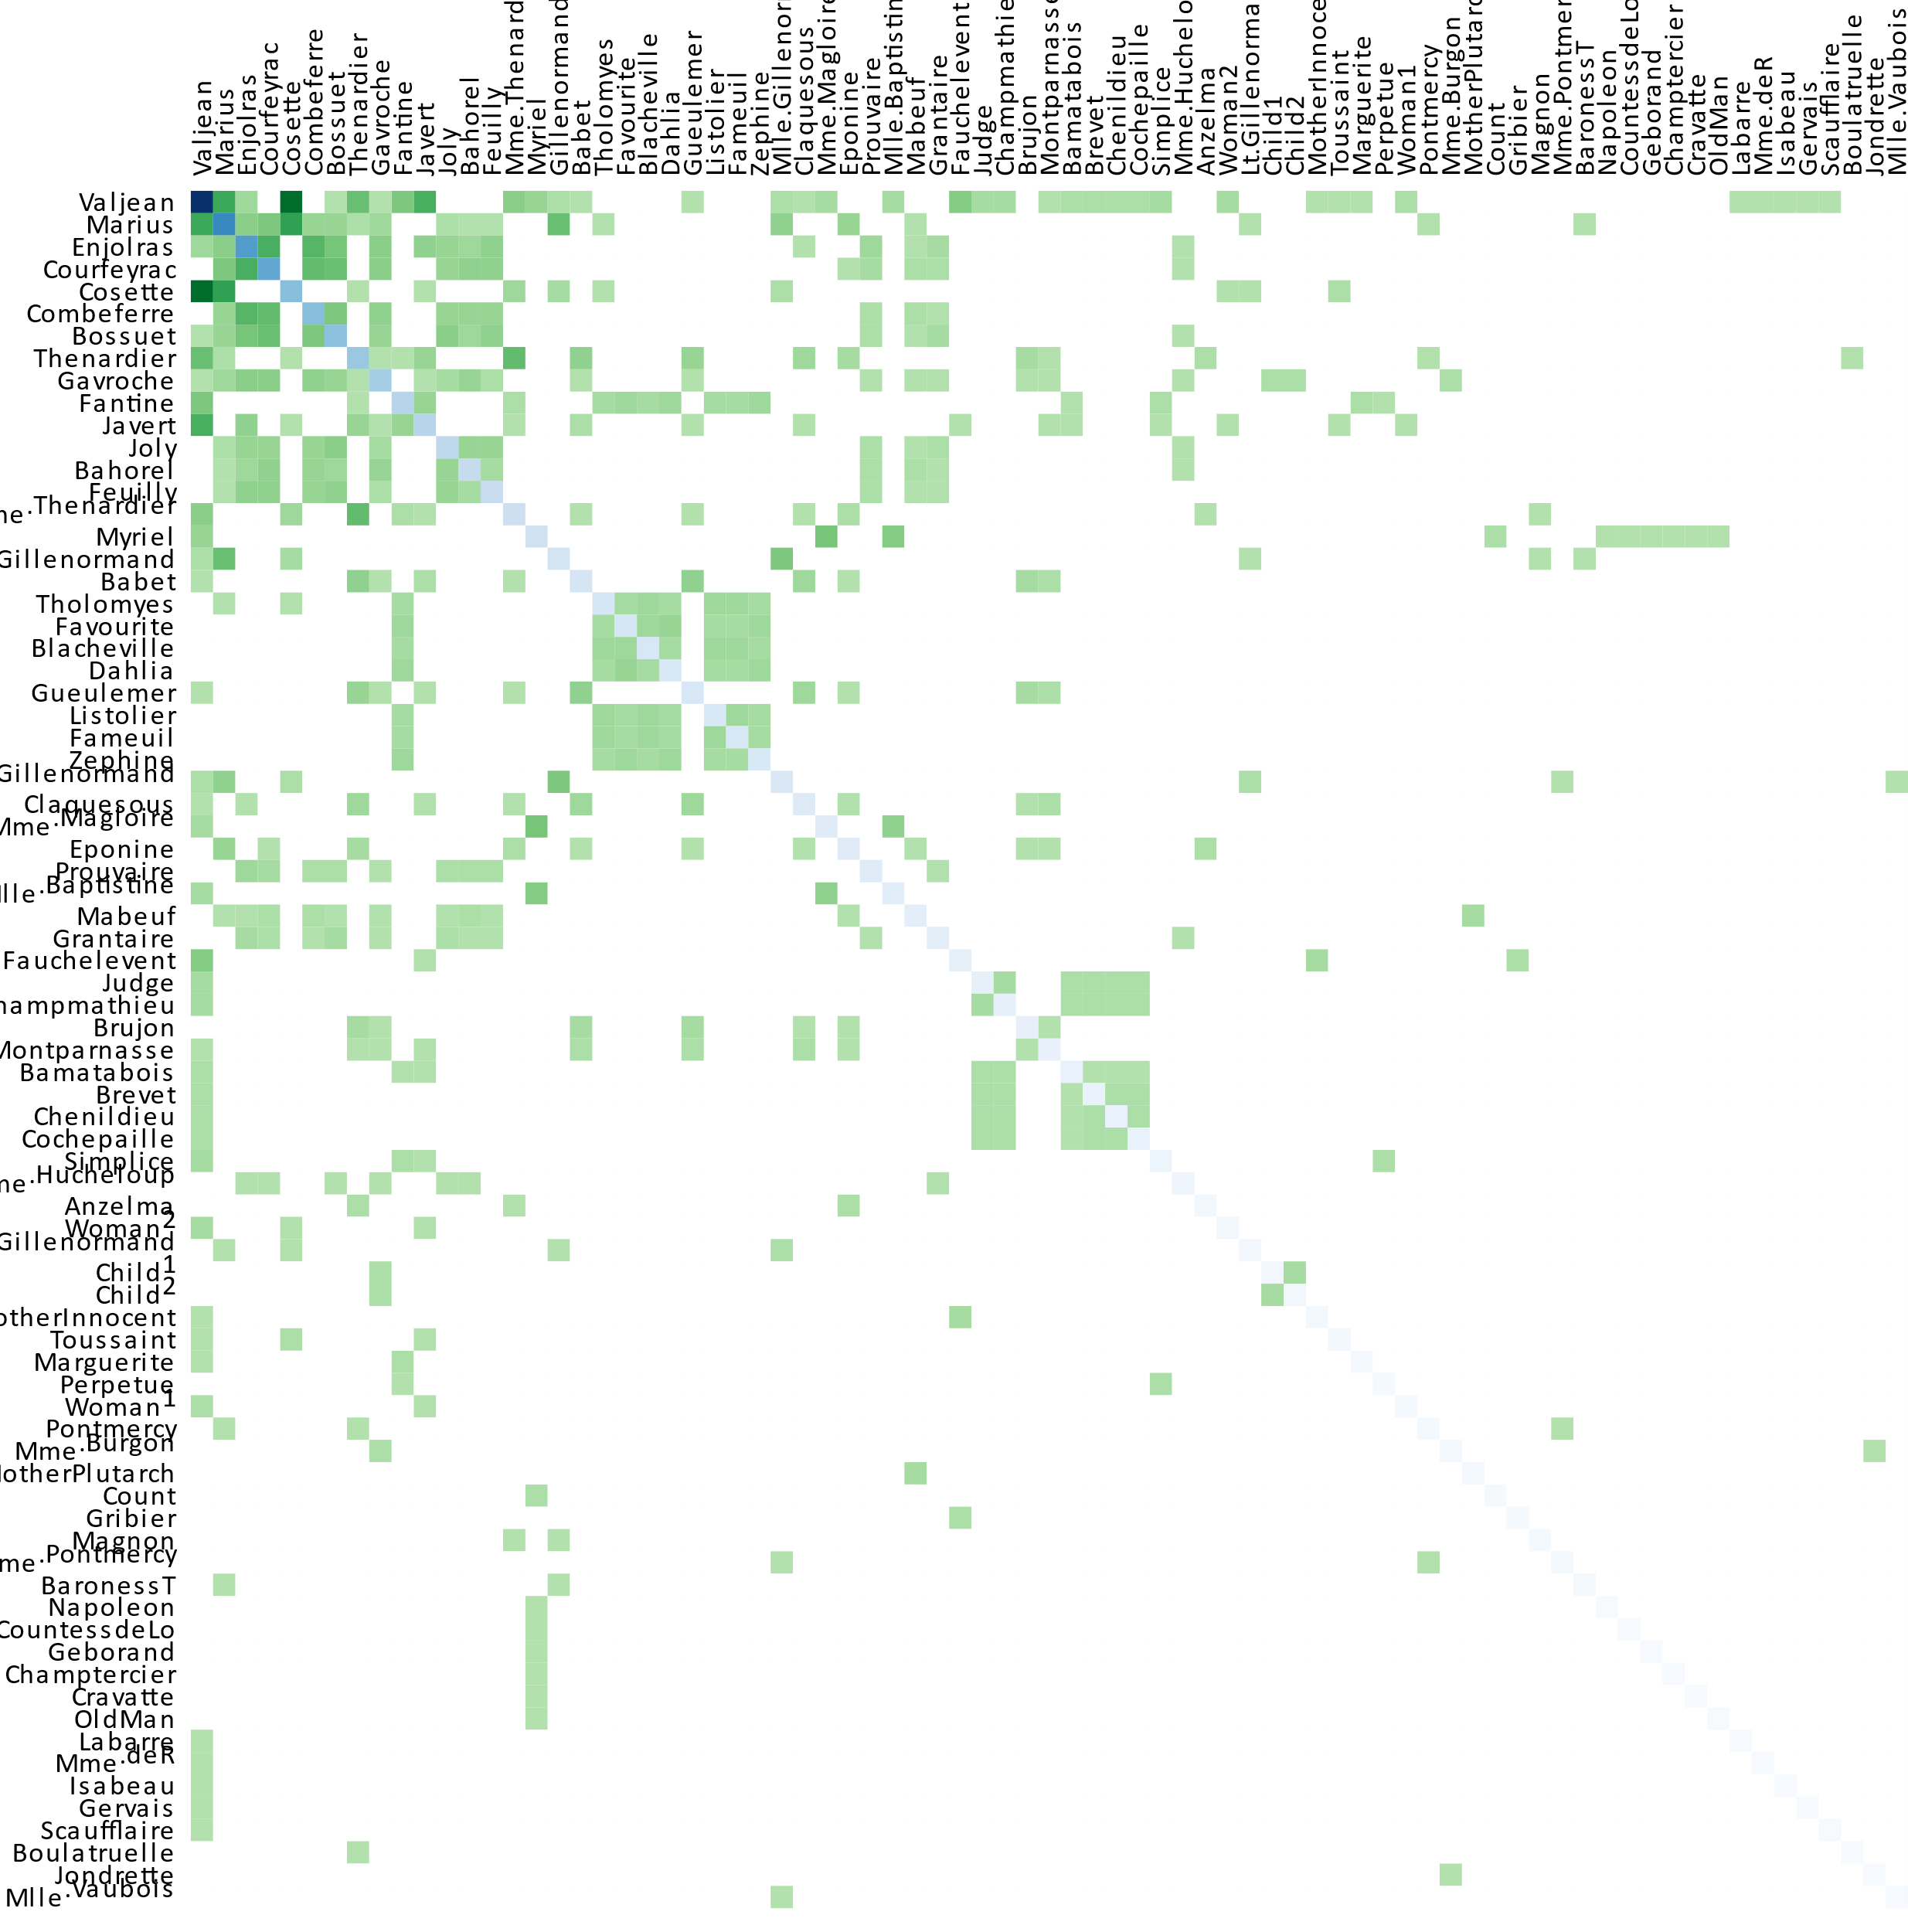
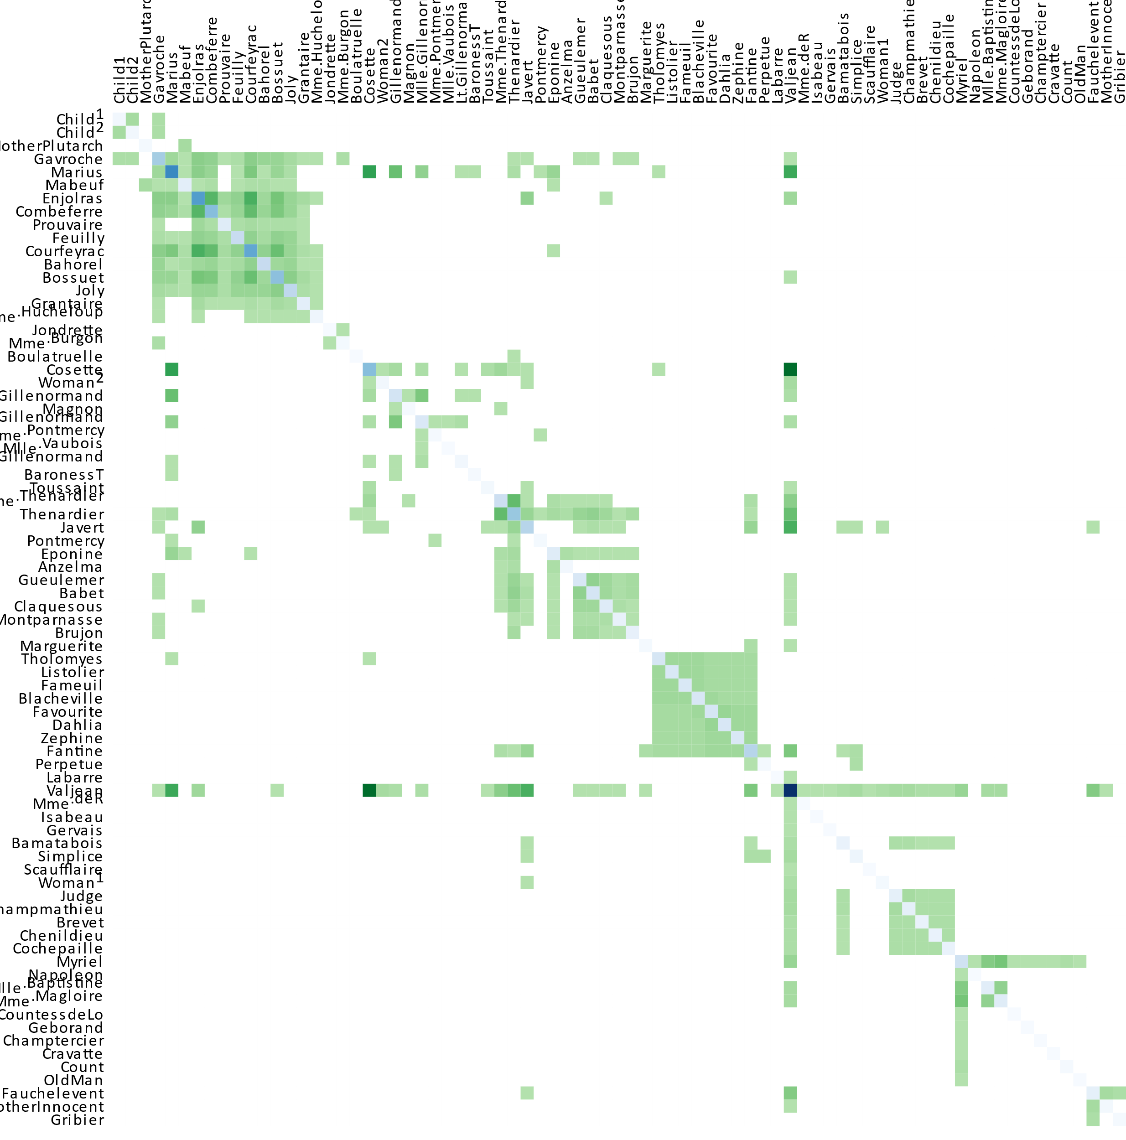
Matrix representations
Important: Ordering of rows and columns affects visibility of patterns
Details on algorithms for matrix re-ordering are described by Behrisch et al.
Ordered by name
Ordered by frequency
Ordered by cluster
Demo at https://bost.ocks.org/mike/miserables/

Slide 35
Matrix representations
Summary
Advantages
Focus on edges of graphs
No complex layout computations necessary
Disadvantages
Quadratic space requirements
Intricate ordering problem

Slide 36
Basic visual representations
Four fundamental visual designs
Node-link representations
Matrix representations
Implicit representations
Hybrid representations

Slide 37
Implicit representations
Node-link and matrix representations show edges explicitly via dedicated graphical primitives
Implicit representations of graphs lack explicitly drawn edges and instead encode them implicitly by the relative position of nodes
Implicit representation work well only if graphs follow some regularities
Hardly applicable to general graphs
Well suited for trees with regular parent-child relationships

Slide 38
Implicit representations
Basic options for implicit encoding
Inclusion (children included in parent)
Overlap (children overlap parent)
Adjacency (children adjacent to parent)
Node-link Inclusion Overlap Adjacency

Slide 39
Implicit representations
Many different tree visualizations based on implicit encoding
Examples
Treemap
Information pyramids
3D sunburst
Many more examples at https://treevis.net
Think about: What type of implicit encoding is used in the examples?
Treemap
Information pyramids
3D sunburst
Notes:
Treemap (inclusion)
Information pyramids (adjacency)
3D sunburst (adjacency)

Slide 40
Implicit representations
Summary
Advantages
Focus on nodes
Use display space efficiently
Disadvantages
Edge visibility reduced
Node visibility may be compromised

Slide 41
Basic visual representations
Four fundamental visual designs
Node-link representations
Matrix representations
Implicit representations
Hybrid representations

Slide 42
Hybrid representations
“
Combine previous approaches to exploit individual advantages
Sparse subgraphs shown via node-link
Dense subgraphs shown as matrix
Tree-like substructures shown via implicit representations
Example: NodeTrix
Sparse parts: node-link representation
Dense parts: matrices
Dynamic transformation between node-link and matrix representation
Each feature is drawn with an algorithm tuned for its topology.
— Archambault et al., 2009

Slide 43
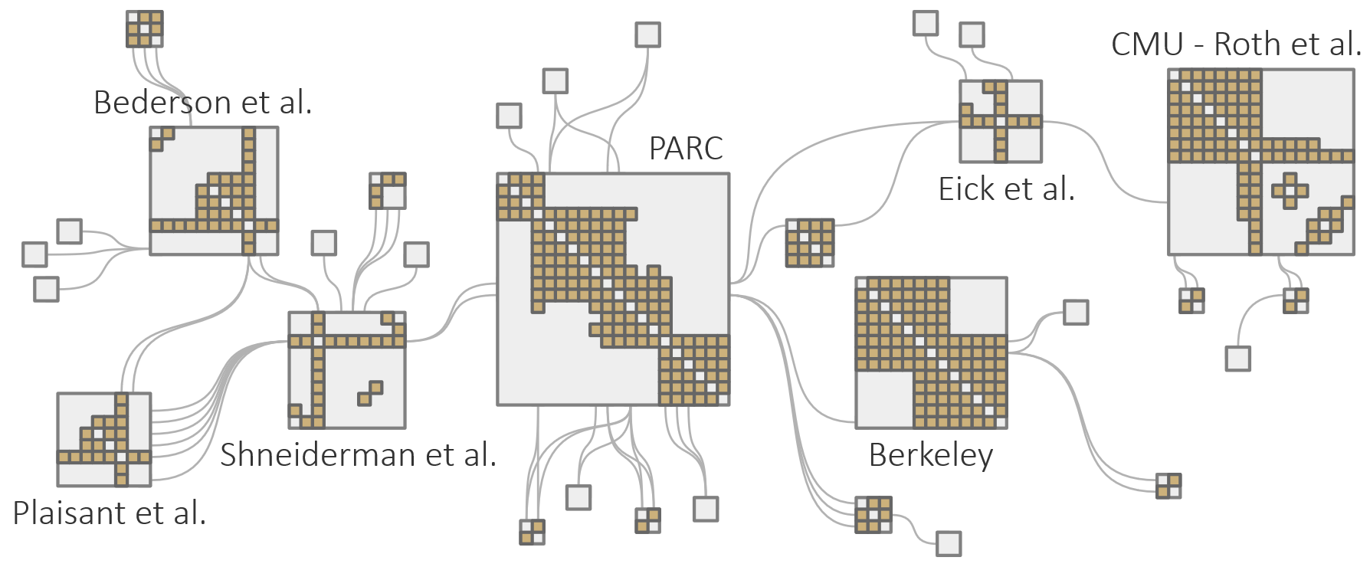
Hybrid representations
NodeTrix (Henry et al., 2007)
Demo video at https://www.youtube.com/watch?v=7G3MxyOcHKQ

Slide 44
Basic visual representations
Summary
Node-link representation
Matrix representation
Implicit representation
Hybrid representation
Next: Visualization of multi-faceted graphs

Slide 45
Visualization of multi-faceted graphs
So far, primarily focused on graph structure
Now, we add additional data facets:
Data attributes A
Time T
Space S
Two-step design process
Decide primary facet whose depiction governs the overall visualization
Incorporate additional facets into based representation from 1.

Slide 46
Visualization of multi-faceted graphs
Two-step design process
Decide primary facet whose depiction governs the overall visualization
Incorporate additional facets into based representation from 1.
Examples:
R is primary, A is secondary → Topology-driven layout
A is primary, R is secondary → Attribute-driven layout

Slide 47
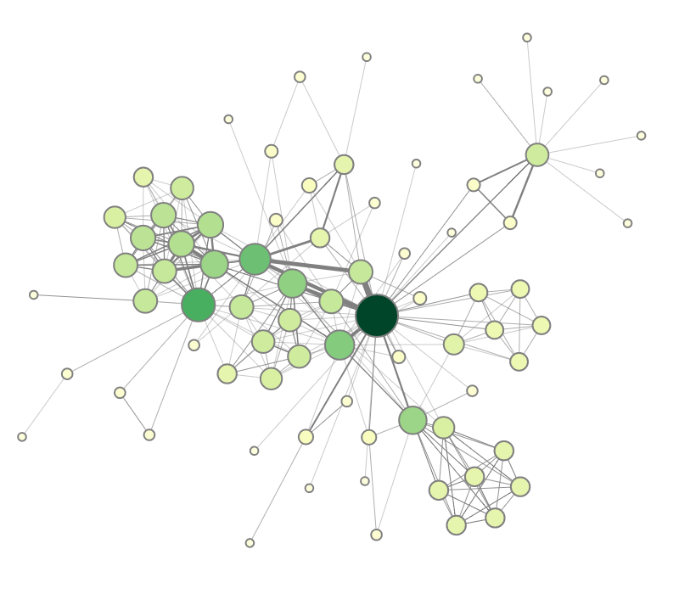
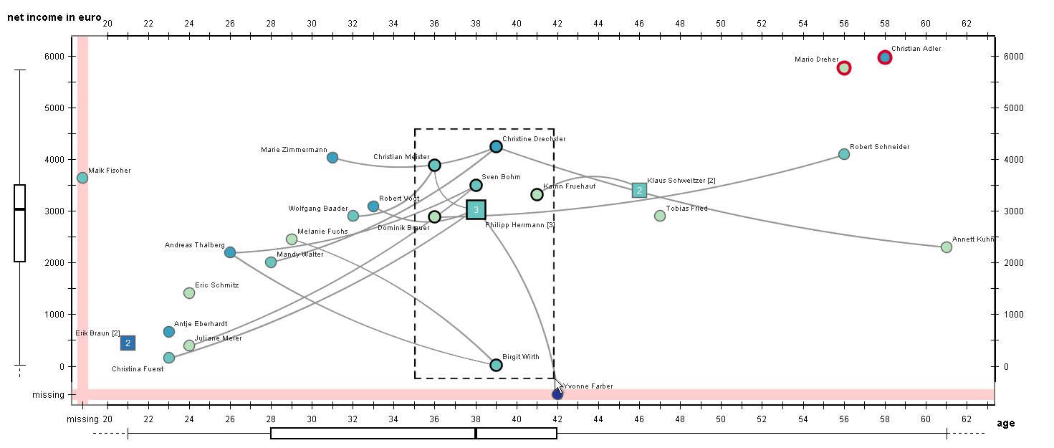
Visualization of multi-faceted graphs
Topology-driven layout
R is primary, A is secondary
Nodes positioned according to graph structure (e.g., force-directed layout)
Attributes encoded via color, size, and width
Attribute-driven layout
A is primary, R is secondary
Nodes positioned according to attribute values (e.g., scatterplot)
Edges represented as links as usual
Eichner et al. (2017)

Slide 48
Visualization of multi-faceted graphs
General composition strategies for multiple facets
Temporal composition
Show one data facet after the other
Spatial composition
Show spatial arrangement of multiple facets
Recall presenting multiple views in space or in time from Lecture 4.
Juxtaposition
Superposition
Nesting

Slide 49
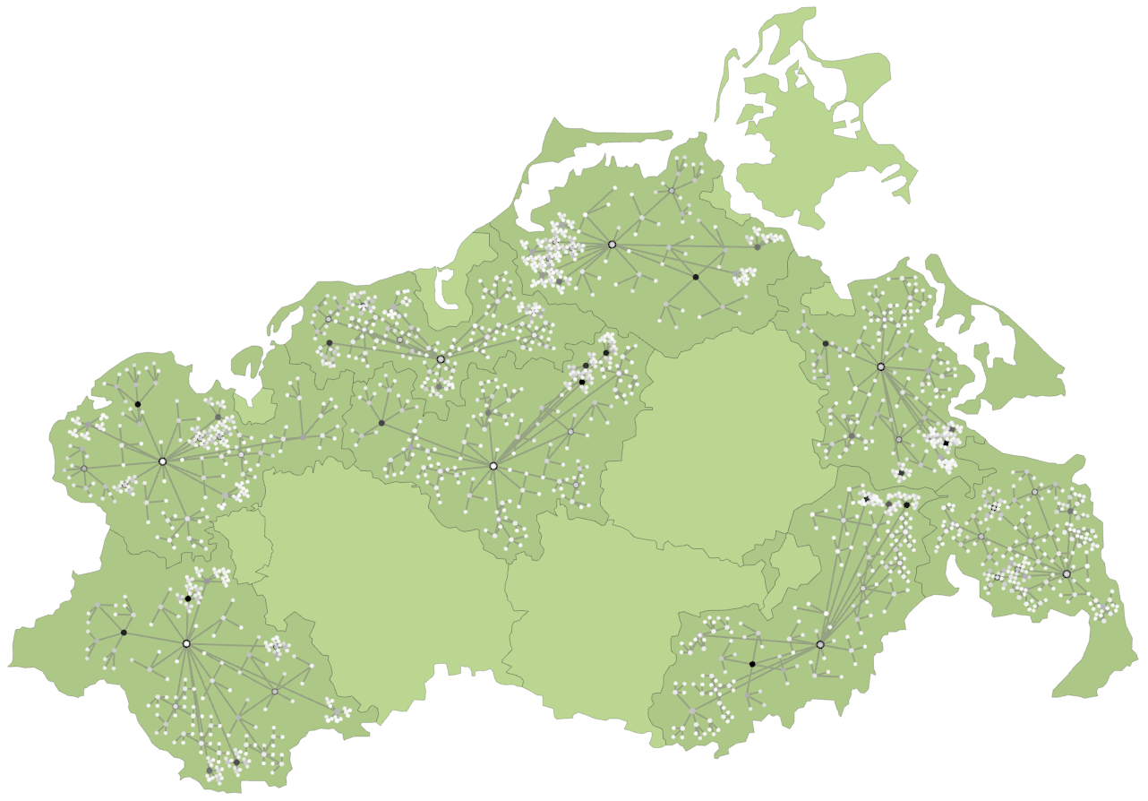
Visualization of multi-faceted graphs
Example: 3D layered map visualization of dynamic spatial trees
Graph facets: R, S, T
S represented as map
R nested into map regions via point-based layout
Hadlak et al. (2010)

Slide 50
Visualization of multi-faceted graphs
Example: 3D layered map visualization of dynamic spatial trees
Graph facets: R, S, T
S represented as map
R nested into map regions via point-based layout
T represented as stacked 3D layers and encoded as colored spikes
Hadlak et al. (2010)

Slide 51
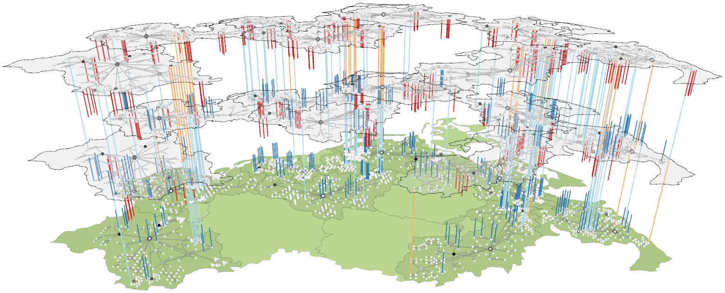
Visualization of multi-faceted graphs
Example: 3D layered map visualization of dynamic spatial trees
Graph facets: R, S, T
S represented as map
R nested into map regions via point-based layout
T represented as stacked 3D layers and encoded as colored spikes
Hadlak et al. (2010)

Slide 52
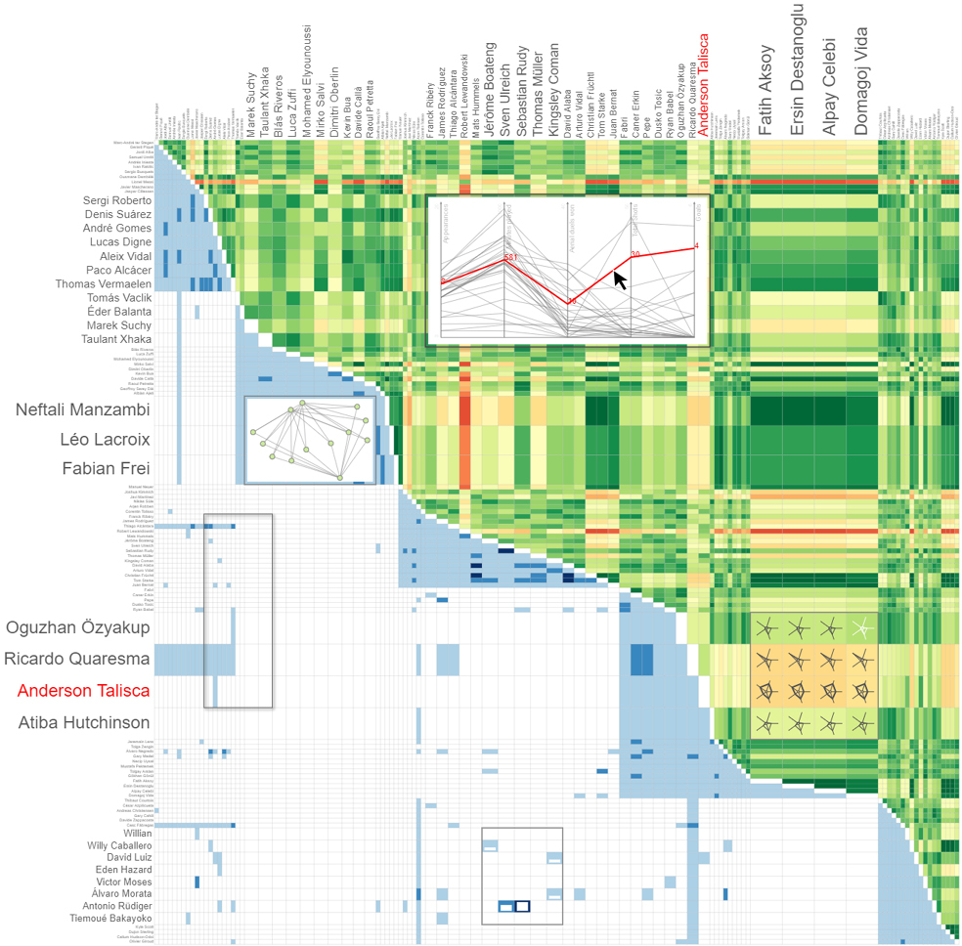
Visualization of multi-faceted graphs
Example: Responsive Matrix Cells
Graph facets: R, A
R represented in lower triangular matrix
Overview of A color-coded in upper triangular matrix as aggregated similarity
Details of A represented in nested views in matrix cells
Nested views respond to size changes
https://vcg.informatik.uni-rostock.de/~ct/software/RMC/index.html
Horak et al. (2021)

Slide 53
Visualization of multi-faceted graphs
Example: Multi-view visualization of multivariate compound graphs
Graph facets: R, A, H (compound hierarchy)
Juxtaposition of data facets in multiple views
Individual views may use superposition
Each view focuses on particular facet
Sum of all views covers all facets

Slide 54
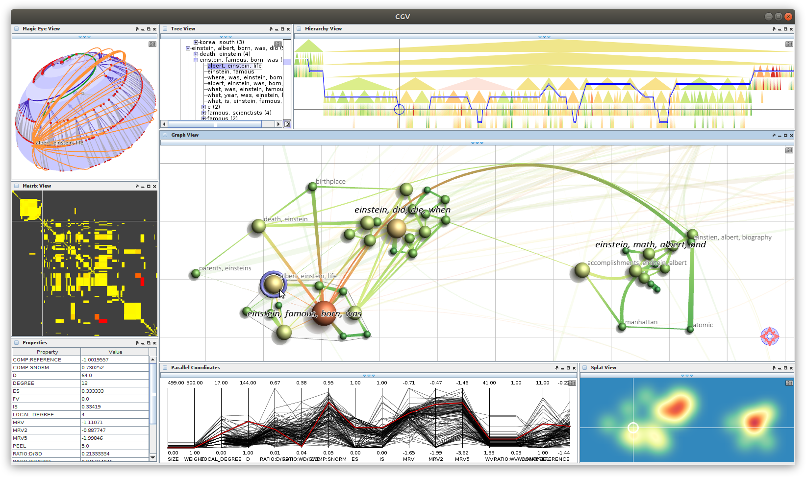
Visualization of multi-faceted graphs
Example: Multi-view visualization of multivariate compound graphs
Fisheye treeview representing textual labels of the nodes of R
Tree view showing H and selected attribute A
Magic Eye View showing H and selected edges from R
Graph layout of R with selected attributes A encoded by size and color
Matrix view focusing on the edges of R and a selected edge attribute A
Parallel coordinates view showing attributes A of nodes or edges in detail
Property view listing A for a selected node
Splat view visualizing the density of graph elements in R
Tominski et al. (2009)

Slide 55
Visualization of multi-faceted graphs
Example: Multi-view visualization of multivariate compound graphs
In order to make sense of multi-views visualization, it is necessary to mentally connect the different representations
This can be supported by coordinated highlighting
Focused graph elements are consistently marked in all views
Tominski et al. (2009)

Slide 56
Summary
Brief introduction to graph data and different facets of graphs
Basic visual representations
Node-link
Matrix
Implicit
Hybrid
Methods for visualizing multi-faceted graphs
Decide primary facet to be communicated
Embed secondary facets

Slide 57
Assignments
Read about “The Aesthetics of Graph Visualization” in Bennett et al., (2007)!
Read about Eades, Fruchterman & Reingold, and Kamada & Kawai algorithms in Sections 12.1, 12.2, and 12.4 from Kobourov’s chapter on “Force-Directed Drawing Algorithms”!
Browse the comprehensive survey on “The State of the Art in Visualizing Multivariate Networks” by Nobre et al. (2019)!
Download Gephi from https://gephi.org/ and create some graph visualizations with different layouts!
Try different layout styles of yEd at https://www.yworks.com/yed-live/!

Slide 58
Questions
How are graphs defined, what graph objects can be relevant to analyze?
What data facets can play a role when visualizing graphs?
Name relevant analytical questions for interactive visual graph analysis!
What are the four fundamental visual representations for graphs?
Outline the basic procedure of force-directed graph layout!
Explain the basic idea of matrix representations!
Draw a small graph as node-link and matrix representation!
What is the difference between explicit and implicit representations?
What is a NodeTrix visualization?
What are general composition strategies for multi-faceted graphs?
What is the difference between topology-driven layouts and attribute-driven layouts, and what are they good for?

